Slide 1
Sentiment Analysis Tutorial10
KDM Spring-2020

Slide 2
Sentiment Analysis
Goal is to perform basic sentiment analysis using python

Slide 3
Supervise vs unsupervised learning
Supervised learning and Unsupervised learning are machine learning tasks.
Supervised learning is simply a process of learning algorithm from the training dataset. Supervised learning is where you have input variables and an output variable and you use an algorithm to learn the mapping function from the input to the output. The aim is to approximate the mapping function so that when we have new input data we can predict the output variables for that data.
Unsupervised learning is modeling the underlying or hidden structure or distribution in the data in order to learn more about the data. Unsupervised learning is where you only have input data and no corresponding output variables.

Slide 4
Python Libraries
NLTK
for classification (nltk Naïve Bayes Classifier)
for data (nltk.corpus movie_reviews)

Slide 5
Naïve Bayes Classifier
it is a classification technique based on Bayes’ Theorem with an assumption of independence among predictors. In simple terms, a Naive Bayes classifier assumes that the presence of a particular feature in a class is unrelated to the presence of any other feature and that is why it is known as ‘Naive’.
Naive Bayes model is easy to build and particularly useful for very large data sets. Along with simplicity, Naive Bayes is known to outperform even highly sophisticated classification methods.

Slide 6
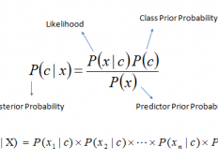
Naïve Bayes Classifier
P(c|x) is the posterior probability of class (c, target) given predictor (x, attributes).
P(c) is the prior probability of class.
P(x|c) is the likelihood which is the probability of predictor given class.
P(x) is the prior probability of predictor.

Slide 7

Code
Import

Slide 8


Slide 9
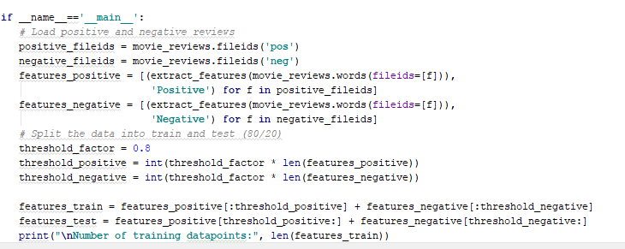
Feature extraction and train/test split

Slide 10
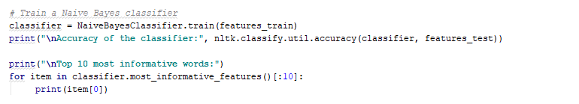
Train the model and perform prediction

Slide 11
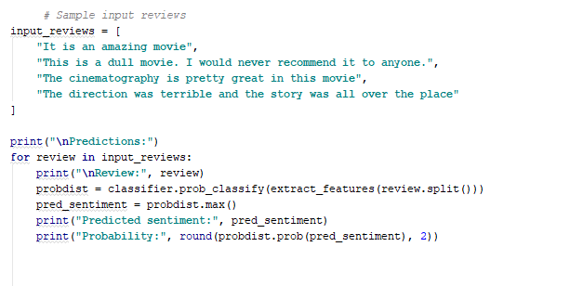
Validate the model on new data

